Slide 1
Data Science for Loan Defaults

Slide 2
Problem Statement and Assumptions
Predicting loan defaults from the customer data.
Customer can take multiple loans, and even if one loan has gone bad, we classify the customer as Bad.

Slide 3
Data
We have 2 tables: Application Data and Loan Performance.
In Application Data we have 647 customers, and in Loan Performance we have 1269 customers.
There is overlap of 640 customers from both the tables, on whom we conduct our Analysis.
For a customer even if single loan has gone bad, we classify them as Bad.

Slide 4
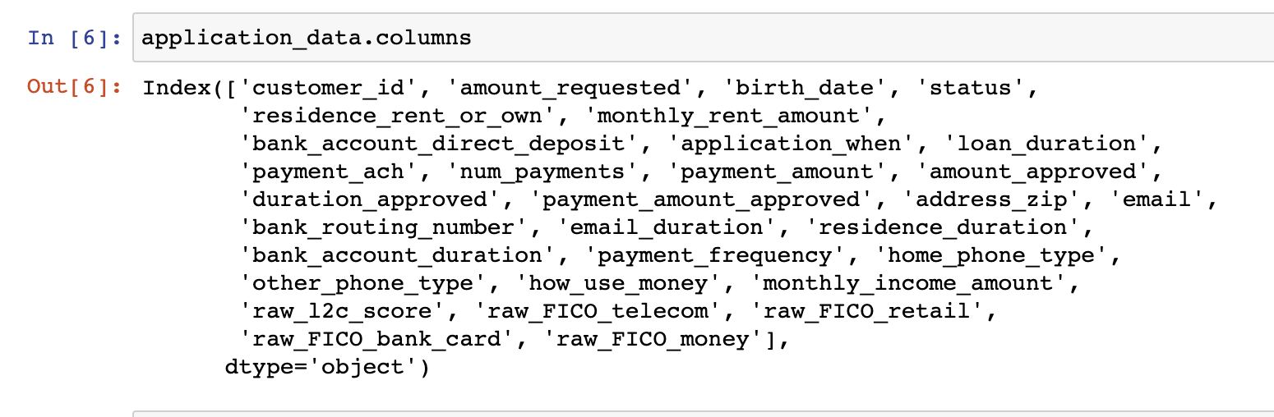
Data (Application Data)
Customers have applied for loans, requesting “amount_requested” for the period of “loan_duration”, stating how much “payment_amount” can they make in the given “num_payments”.
Bank approves amount, payment amount and duration (approved columns) and scores the customer (score columns)

Slide 5
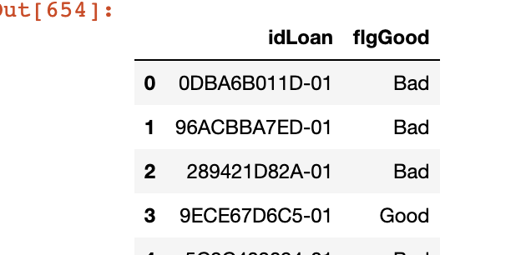
Data (Loan Performance)
This column states whether a particular loan is good / Bad.
First 10 characters is customer Id (in Caps) which can be used to join the Application Data.
Overlap of 640 customers between 2 tables, and single Bad loan will classify customer as Bad. (We have Flagged it with column name “Bad”.

Slide 6
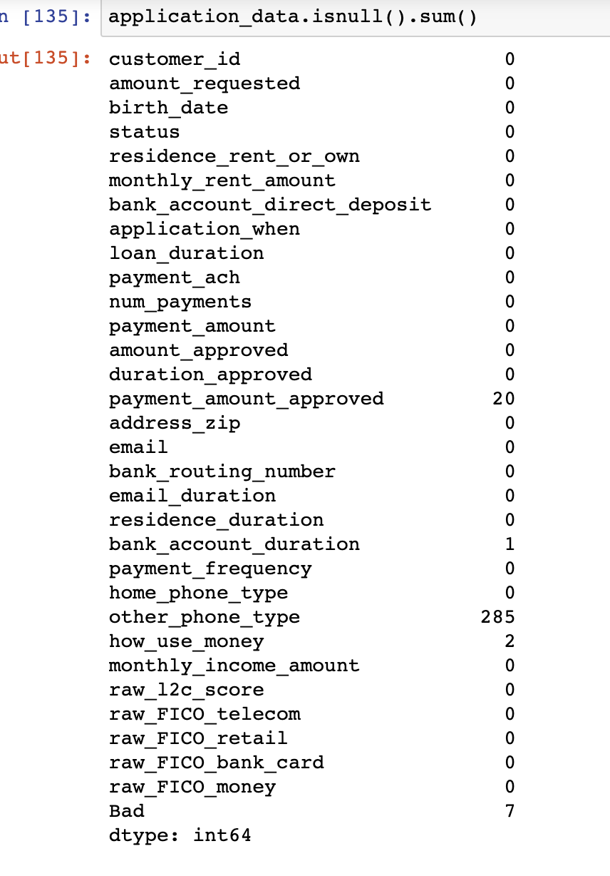
Null Count Info (After Merging)

Slide 7
Decisions to Handle Null Values
Payment Amount Approved = Payment Amount (couldn’t see any specific pattern to why they were NaN)
Bank Account Duration and Other Phone Type: Majority label
Drop Customers with no classification.

Slide 8
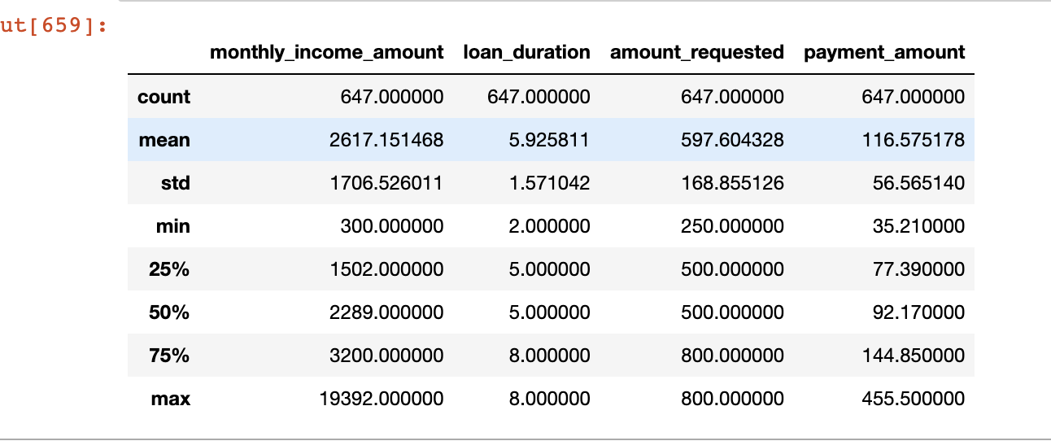
Handling Outliers
Monthly Income Amount had huge outliers, which were replaced by mean + 3 std.

Slide 9
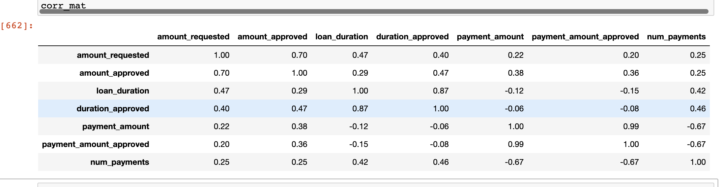
Correlation
Most importantly number of payments and payment amount are relatively correlated.
Fico scores are also correlated with each other.

Slide 10
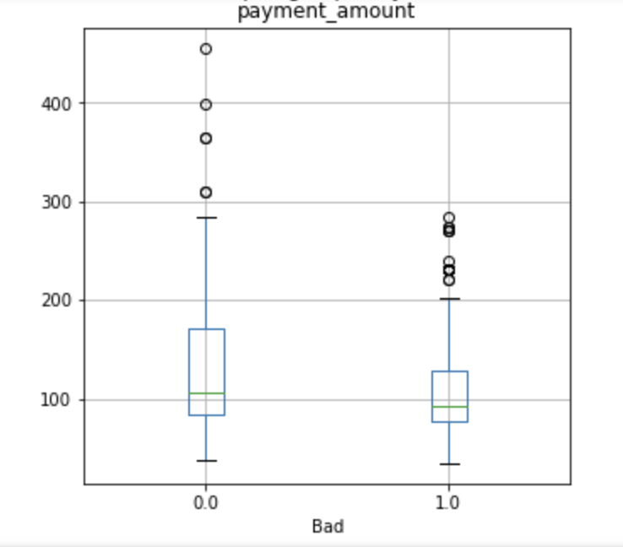
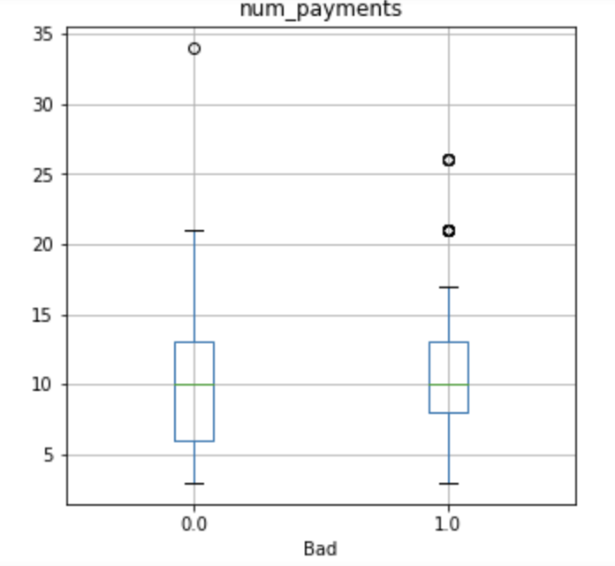
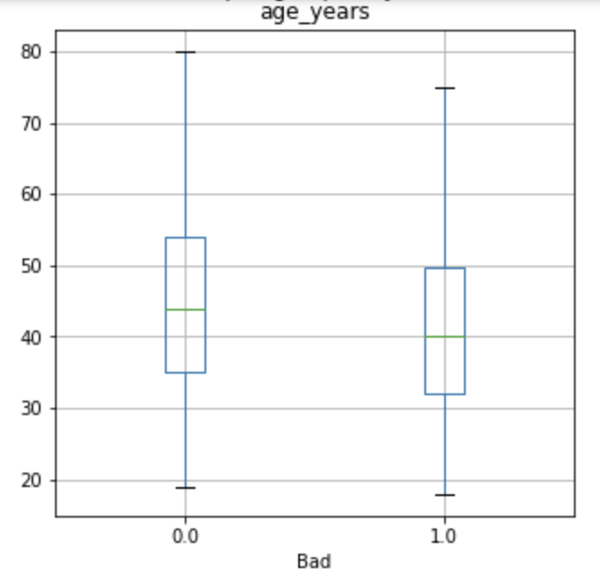
Numeric Features vs Target Variable
Age_years is feature created.
Payment Amount, Num Payments and Age seem to be visually affecting the output.
Apart from these columns, the Fico score columns also have low P value from One way Anova test.
P values: (age_years = 0.00013, num_payments = 0.0083, payent_amount = 0.0002)

Slide 11
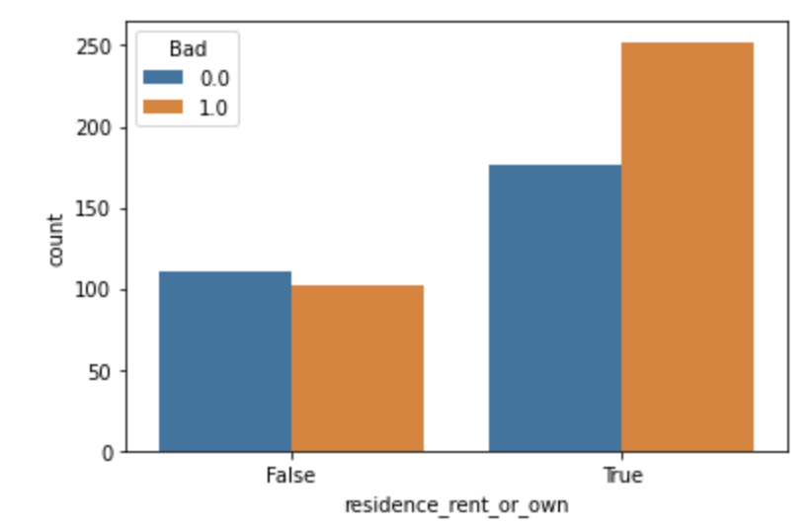
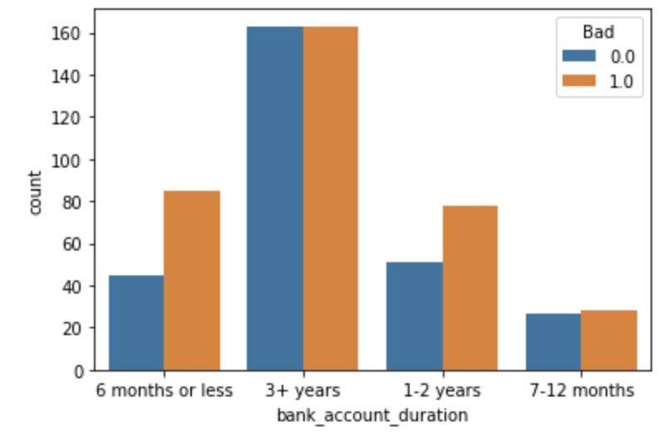
Categorical Features vs Target Variable
Chi squared statistic tests employed
P values (residence_rent_or_own = 0.012, bank_account_duration = 0.012)

Slide 12
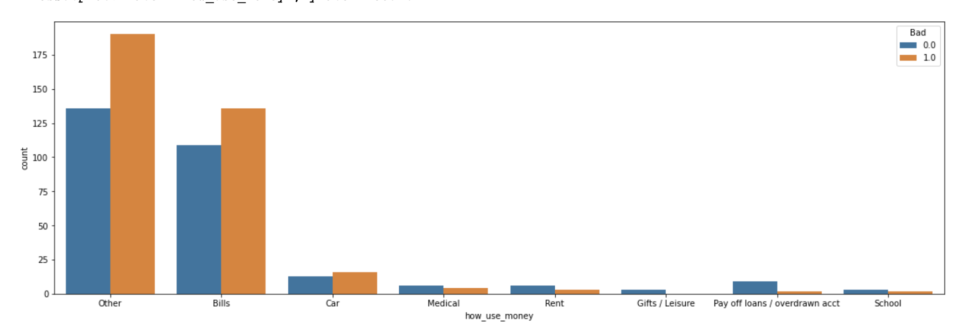
Categorical Features vs Target Variable 2
Chi squared statistic tests employed
P values (how_use_money = 0.048)

Slide 13
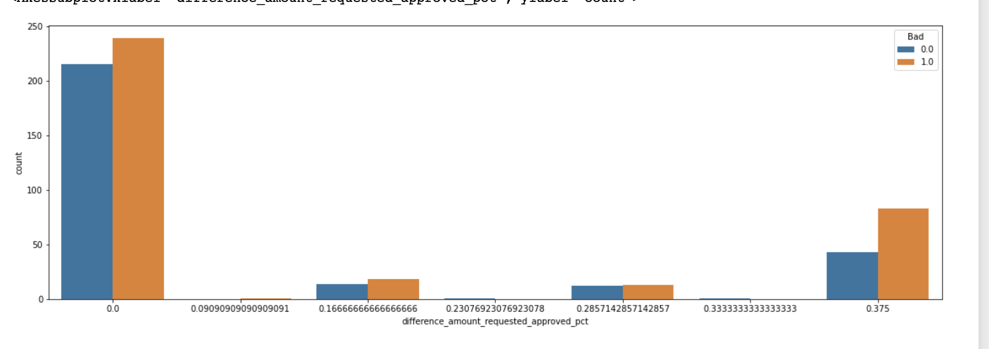
Feature Creations and Engineering
We have noticed that in some cases, amount_approved is lower than amount_requested.
Above graph shows percentage difference vs Good / Bad loans.
We notice that when the difference is >30%, there are more chances of defaulting.
Amount_requested, age_years, monthly_rent_amount, payment_amount, loan_duration and Fico scores have low p-value in One Way Anova test.

Slide 14
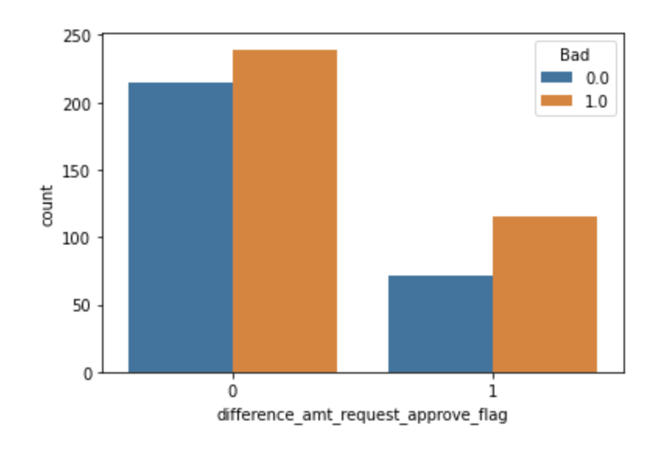
Feature Creations and Engineering 2
Chi square test applied vs output.
The difference flag is important, p value = 0.0418

Slide 15
Feature Creations and Engineering 3
Interaction terms w.r.t. numeric features and Difference_amount_approved_requested_flag (explained in previous slide)

Slide 16
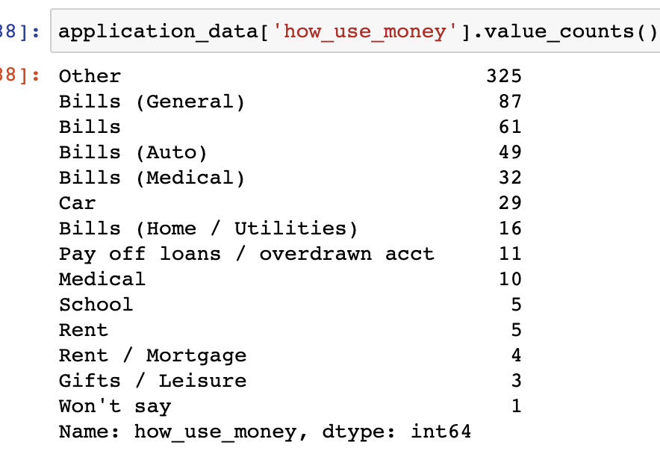
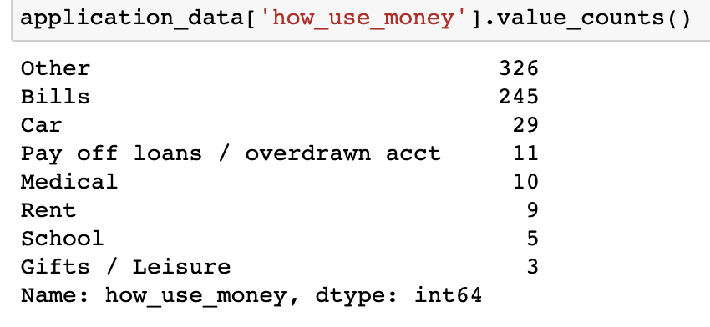
Feature Creations and Engineering 4
How_use_money feature modified (grouping similar items)
Original vs New Below

Slide 17
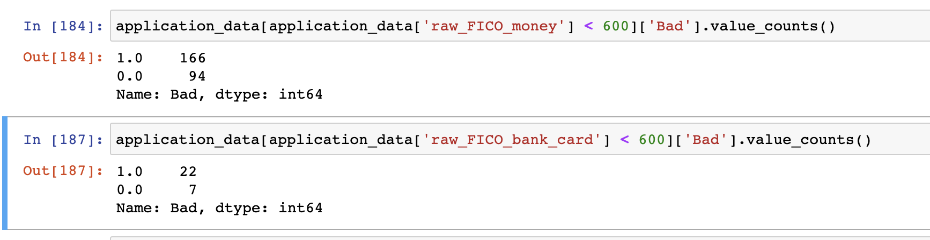
Feature Creations and Engineering 5
Flagging Raw Fico money and Raw Fico Bank Card, 1 if <600, else 0.
Fico Bank card < 600 defaulted more than usual.

Slide 18
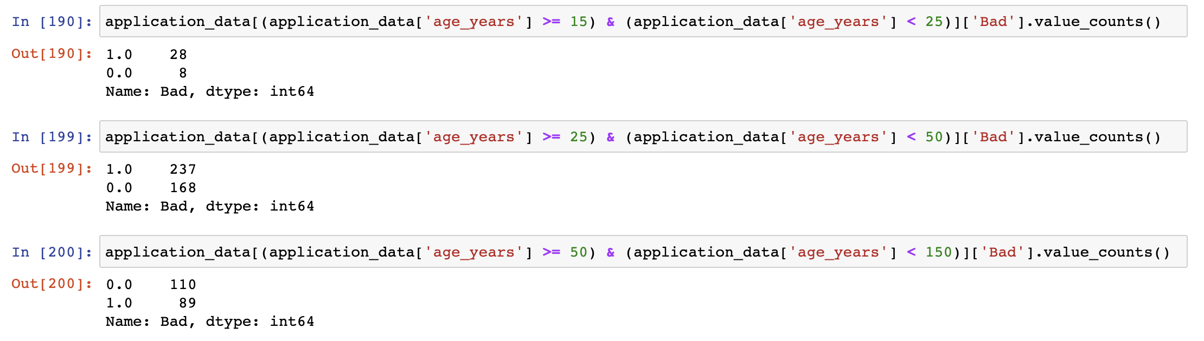
Feature Creations and Engineering 6
Binning Age into Young, Mid and Old.
People younger than 25 defaulted more, and older than 50 defaulted less.
Bins: Young (15 to 25), Mid (25 to 50), Old (Above 50).

Slide 19
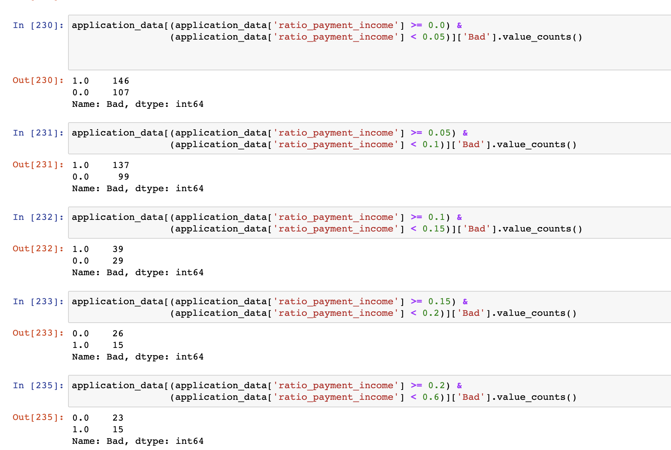
Feature Creations and Engineering 7
Ratio of (Payment amnt approved / [income – rent + delta])
This delta has been kept = 10 for now, but with more data we can have better values (more on that later).
Strange behavior: The smaller ratio people default more (expected was higher ratio people default more)

Slide 20
Machine Learning Modeling
The data is less. So a model with high complexity (lot of parameters, or larger decision tree) may not work effectively as they tend to rely on more data.
High bias low variance models (Logistic Regression, Naïve Bayes classifier) may work, and may not overfit much to training data, but chances are they will give poor accuracy.
High complex model will tend to overfit to training data.
We will apply Gradient Boosting algorithm and Naïve Bayes algorithm, one being Boosting ensembling, and the other being simple model.
We will evaluate with criteria of AUROC score along with accuracies, and play around with probabilities.
Train data and test data splits are 512 and 128 respectively, with 282 and 74 Bad loans respectively.

Slide 21
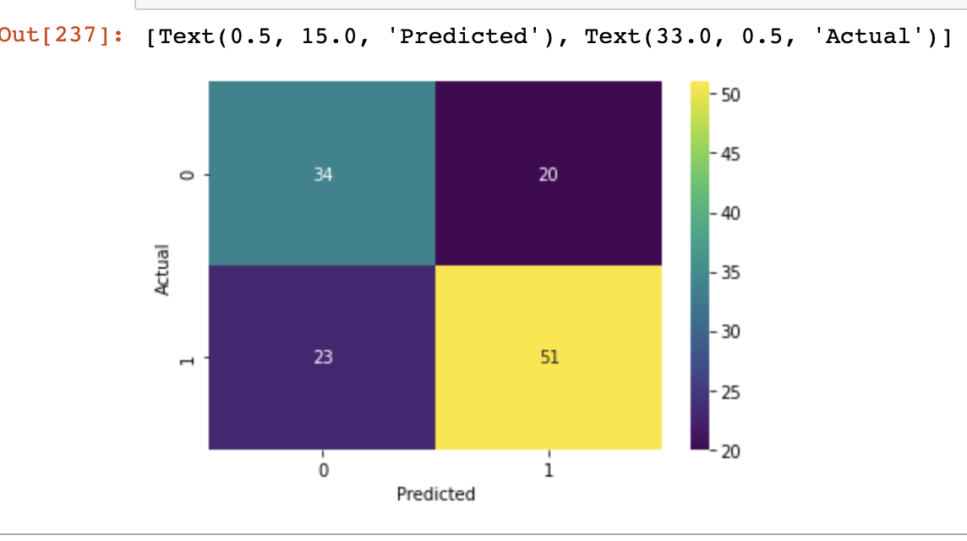
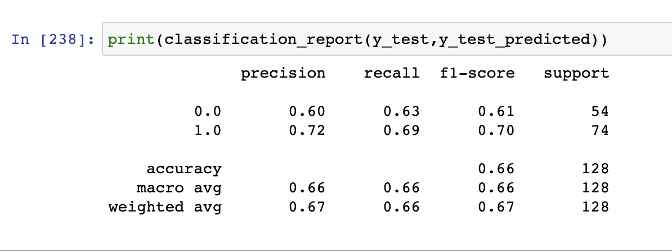
Gradient Boosting Classifier
Parameters: Learning Rate = 0.3 n_estimators = 50 max_depth = 5
Roc score train = 1.0 Roc score test = 0.697

Slide 22
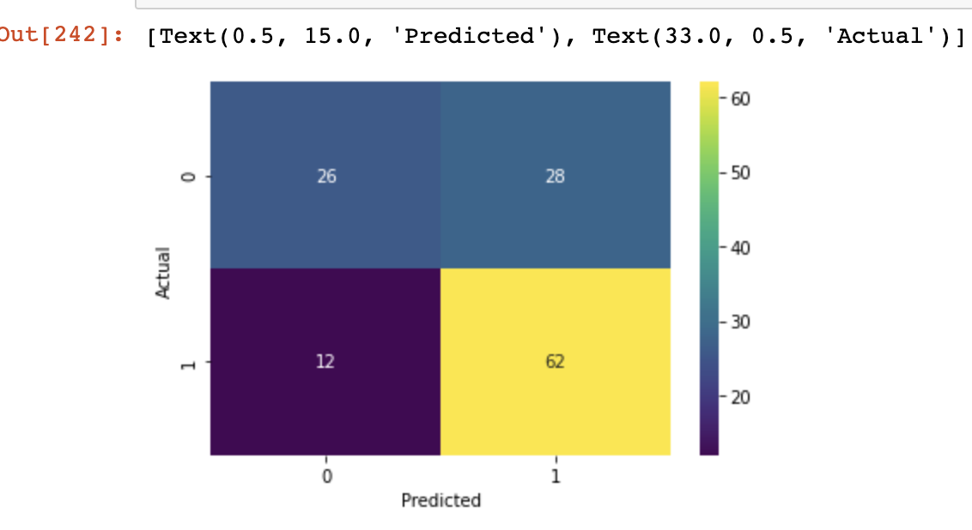
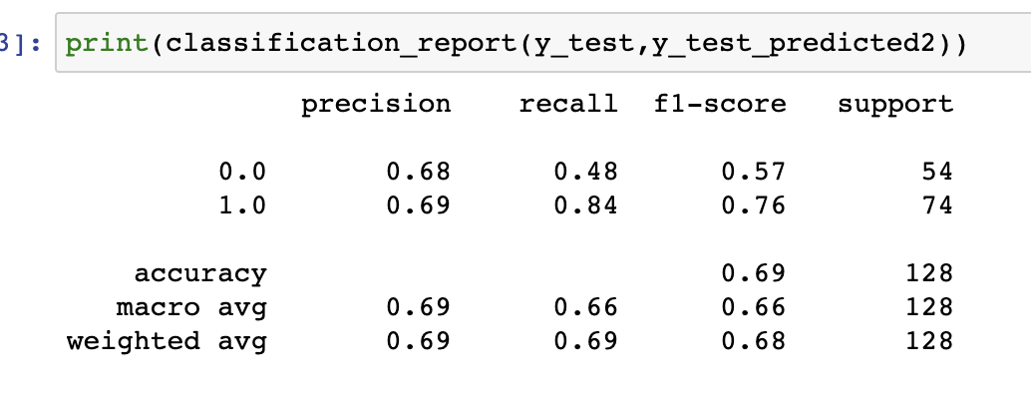
Gradient Boosting Classifier (with Probability Threshold = 0.3)
Parameters: Learning Rate = 0.3 n_estimators = 50 max_depth = 5
Roc score train = 1.0 Roc score test = 0.697

Slide 23
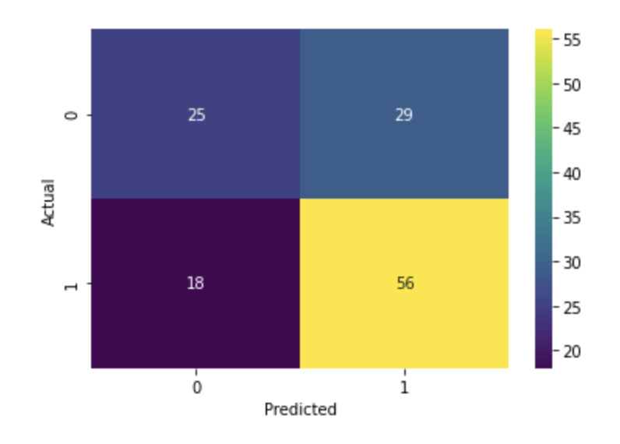
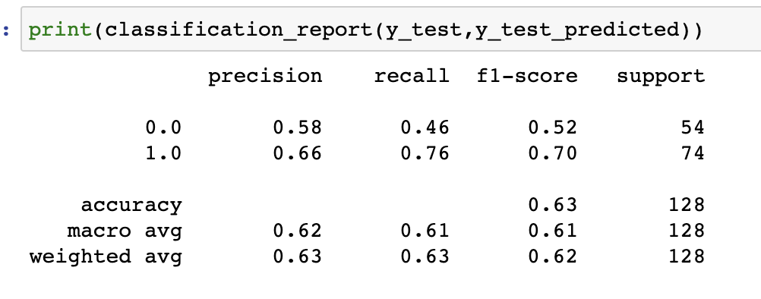
Naïve Bayes Classifier
Parameters: None
Roc score train = 0.97 Roc score test = 0.65

Slide 24
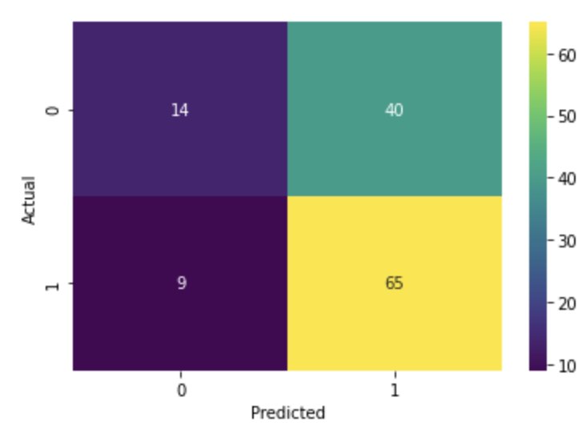
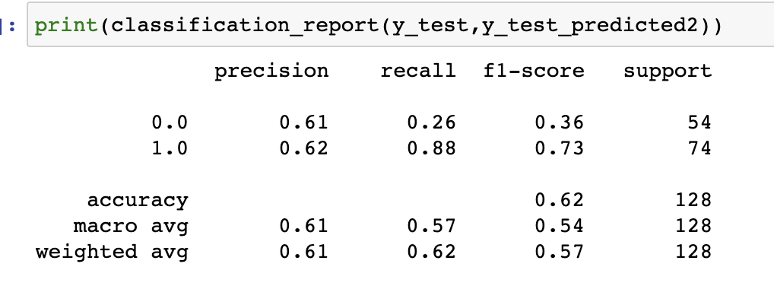
Naïve Bayes Classifier with Probability threshold = 0.3
Parameters: None
Roc score train = 0.97 Roc score test = 0.65

Slide 25
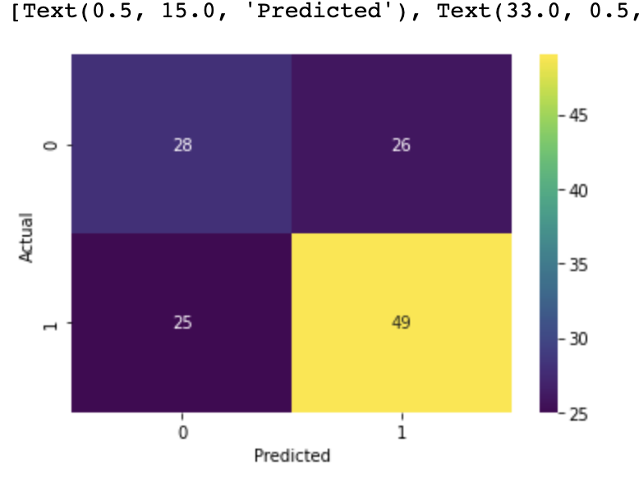
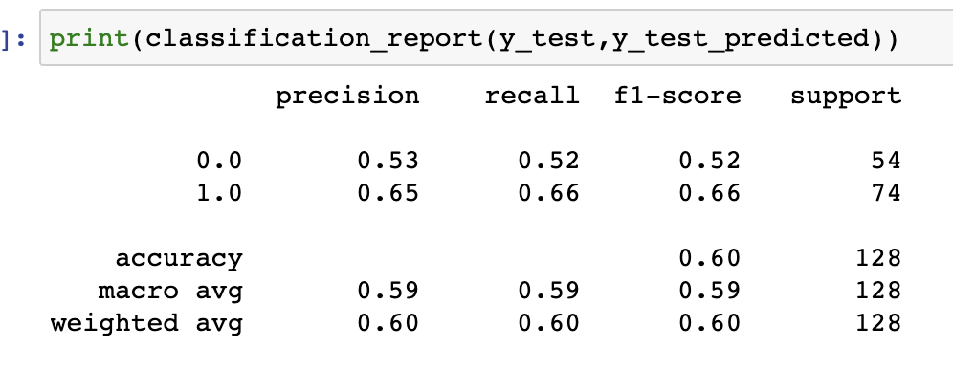
Gradient Boosting Classifier (with no feature engg)
Parameters: Learning Rate = 0.3 n_estimators = 50 max_depth = 5
Roc score train = 1.0 Roc score test = 0.60

Slide 26
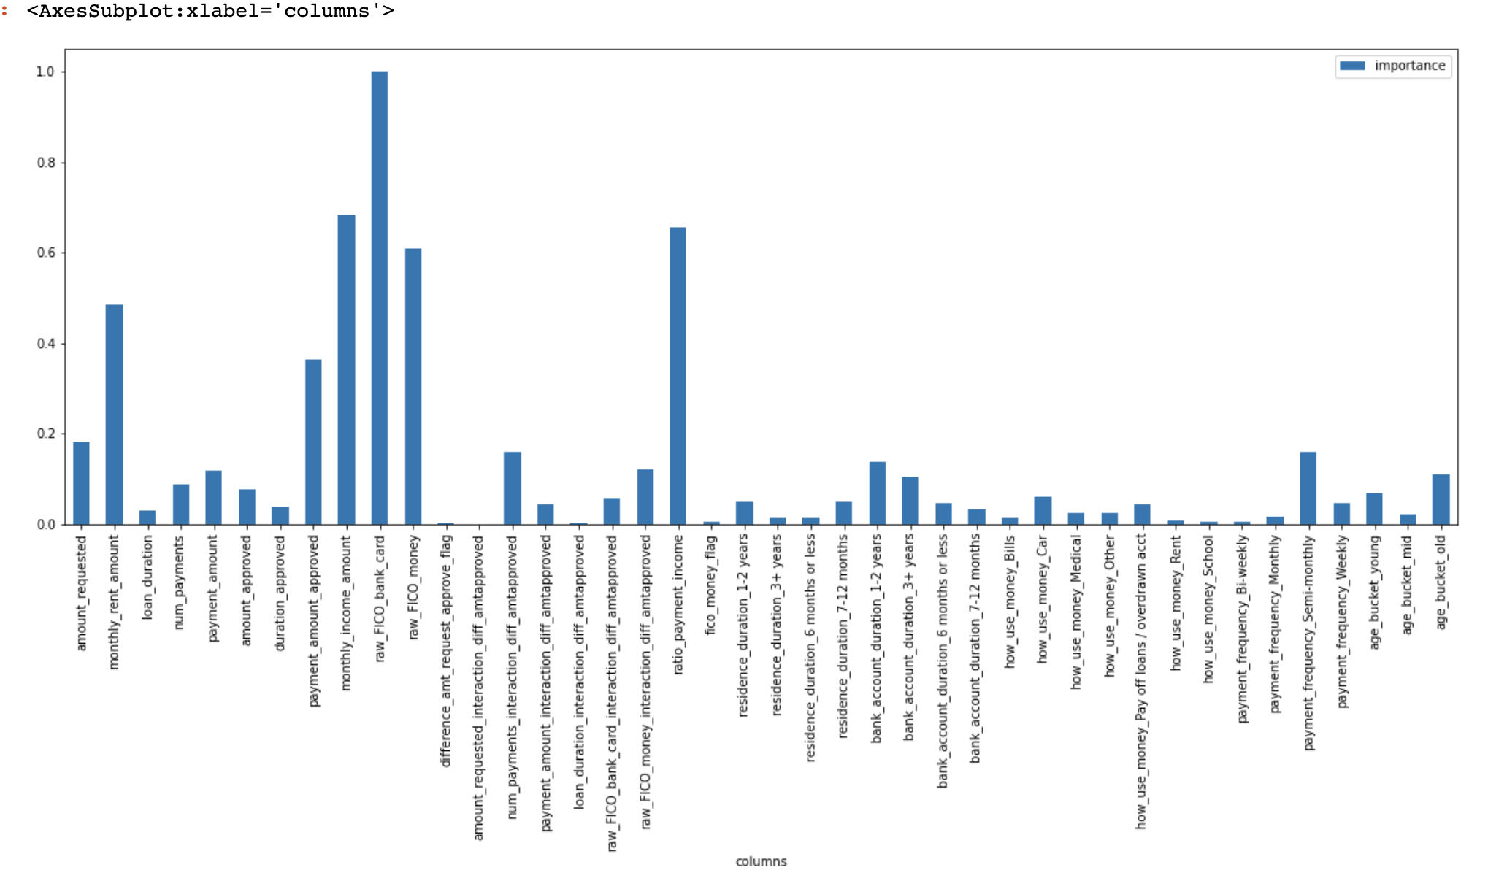
Feature Importance

Slide 27
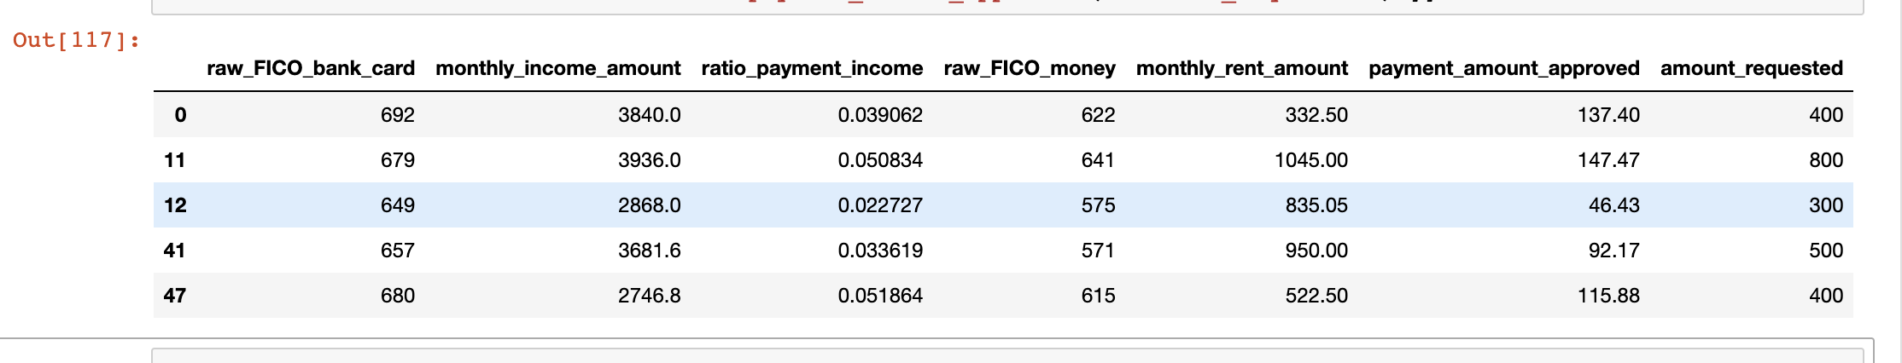
What If Analysis (with Imp features)
We can change some of the features like monthly income amount and monthly rent to see if the classification gets it different.
Example: New income = 1.2*income, new rent = 0.95*rent.
Analyzing on 51 True Positives, 5 of them; if their income increased, may show potential chance of non defaulting.

Slide 28
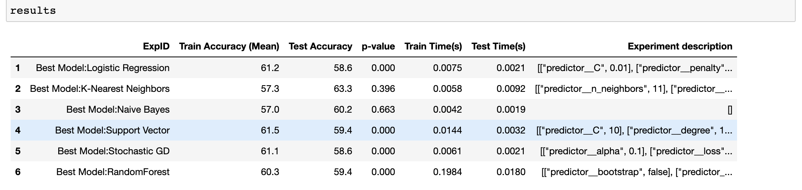
Additional Models by GridSearchCV

Slide 29
Future Scope
The boosting algorithm will work better with more data. We have good number of features for it to work.
With better domain knowledge, Fico scores can be engineered better.
The purpose of the loan is ‘Other’ for most of the data points. If this field is more specific, we can retune / retrain the model.
GridSearchCV can be employed to search for more hyperparameters.
We can make monthly model based on ytd loan payments.
If we have data of Credit card statements, Job Industry, Number of family members, Salary statements (if he / she has Savings or checkings account), we can have more information, and so more features.
Based on this data we can also analyze if a person is suddenly out of job / laid off, which can impact loans.

Slide 30
Questions and Thank You

Slide 31

Free templates for all your presentation needs
For PowerPoint and Google Slides
100% free for personal or commercial use
Ready to use, professional and customizable
Blow your audience away with attractive visuals

